Slide 1
UI/UX Design

Slide 2
Identify design principles in applications
Consider color choice in applications and create palettes with appropriate contrast
Create wireframes taking design principles into consideration

Slide 3
Proximity
Enclosure
Similarity
User Experience
Complementary Colors
Analogous Colors
Wireframes

Slide 4
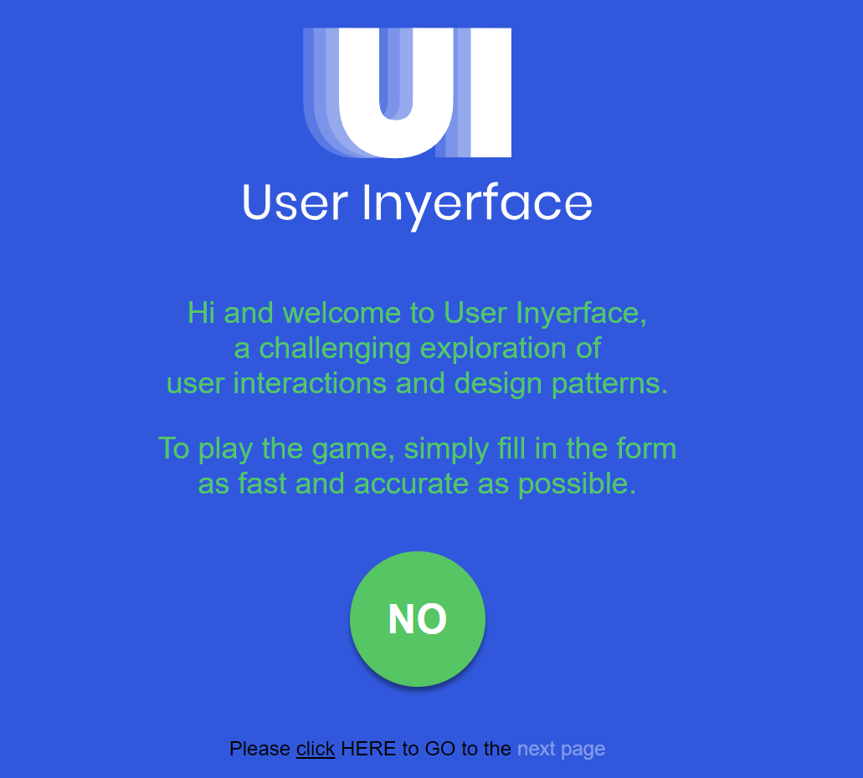
Warm-Up
A “good” user interface often goes unnoticed.
That’s when you know the developer did a great job of creating technology with the user in mind. But what does it look like when a developer doesn’t think about the user experience?
Head to userinyerface.com to experience a “bad” user interface for yourself!

Slide 5
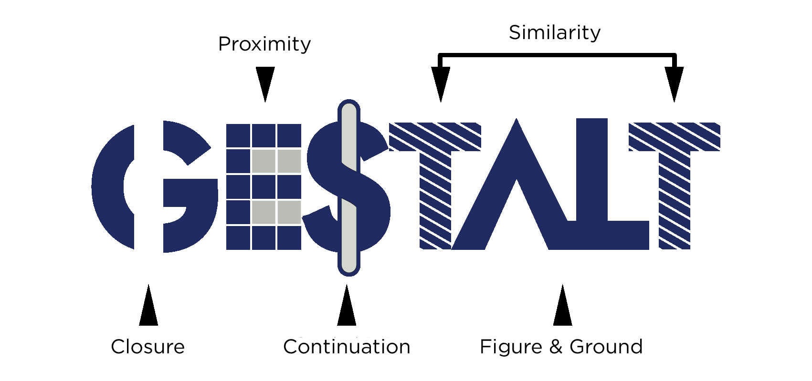
Design Principles
Gestalt Psychology is a concept used to describe how we perceive the world around us. “Gestalt” generally refers to “shape” or “form”.
Humans are hard-wired to see patterns and apply structures to quickly understand their surroundings.
We can perceive objects as complete units and patterns vs. as a series of unrelated parts.

Slide 6
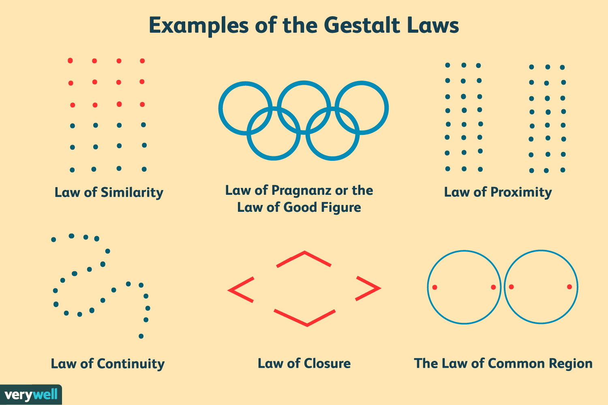
Design Principles
Gestalt principles explain how our minds group smaller elements into complete objects.
These principles can be thought of as mental shortcuts for visual problem solving.
Today, we will look at 3 of them.

Slide 7

Law of Proximity
When elements are close together, we perceive them to be part of a group.
Even though the image above is made up of unrelated elements:
a column on the left,
a square to the upper right,
a short row in the lower right
‹#›

Slide 8

Law of Enclosure
Items enclosed within a border or with a different background color are perceived to be related.
A figure will be perceived as separate from it’s background.
A border provides a separation.
‹#›

Slide 9

Law of Similarity
Objects that look similar are naturally grouped in our perception.
This occurs even when the similar elements are not physically adjacent.
In this example, despite the similar scale and distribution of shapes, we see columns of squares and circles.
‹#›

Slide 10
Explore
Go to a few of your own favorite mobile apps.
Find an example of each of the three laws we just learned about.
Be ready to share out!

Slide 11
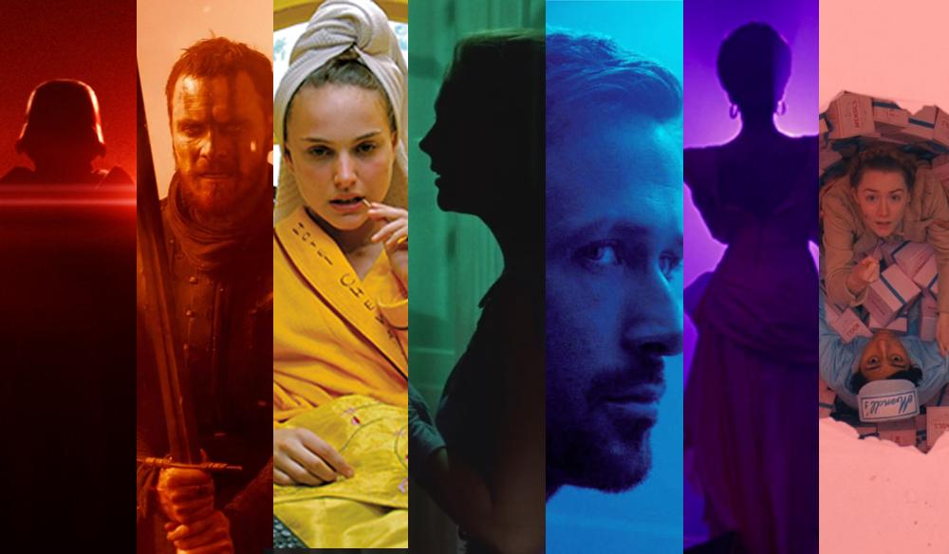
“Color is a powerful form of communication. We are so attracted to color and so repelled by it that even if the coolest design were presented to us, if we didn’t like the color, we wouldn’t like it at all.”
Joanne Chang,
from Hack Design’s
“Building Color Confidence”

Slide 12
Is there a color that instantly brings a specific feeling or meaning to mind?

Slide 13



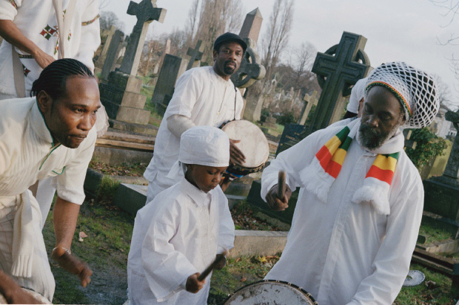
Color Carries Meaning
It is important to be aware that colors can have very different connotations and associations based on different cultural traditions, countries, religious beliefs, etc.
White is also the color of mourning in some cultures
White can symbolizes purity, fulfillment, and brightness.

Slide 14
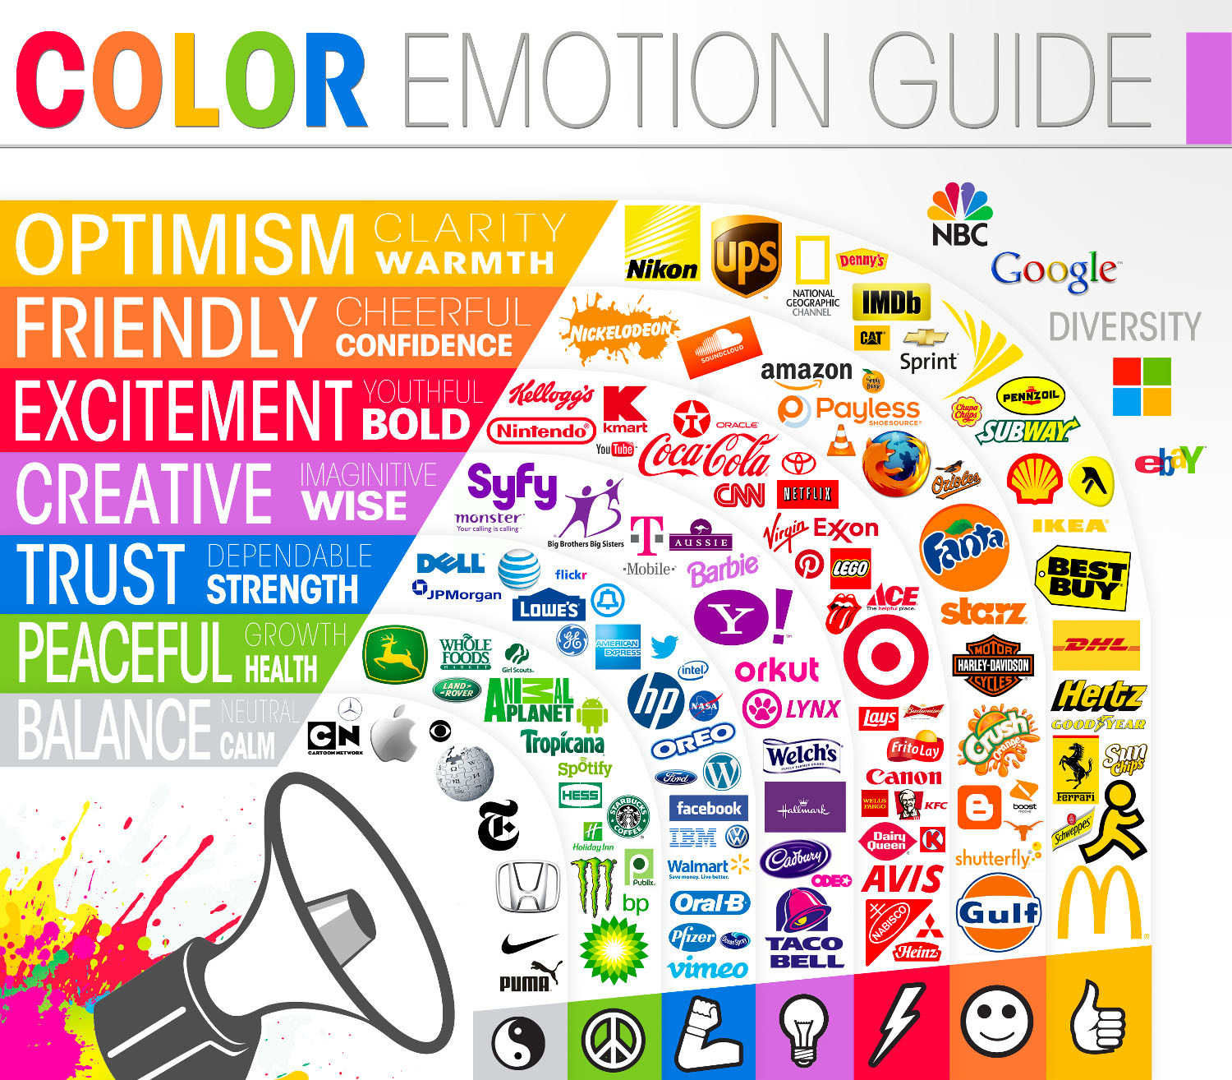
Color Can Invoke Emotion
There are three general groupings of colors and the colors within each of these groups tend to share similar meanings:
warm colors are generally positive and energetic
cool colors are calming and relaxing
neutral colors are more conservative

Slide 15
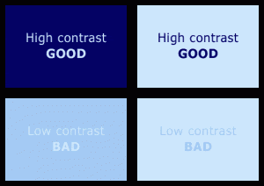
Using Contrast to Enhance
Contrast is the difference between two colors.
We usually want a high contrast, but it should not be too alarming or unsettling.
Black and white create the highest contrast possible.

Slide 16
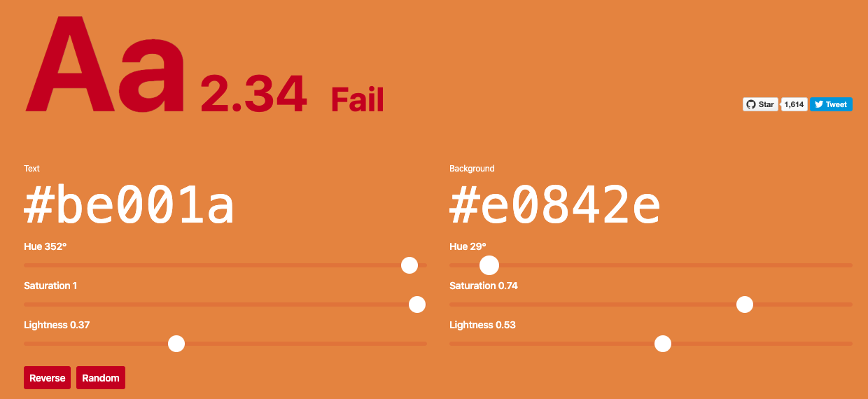
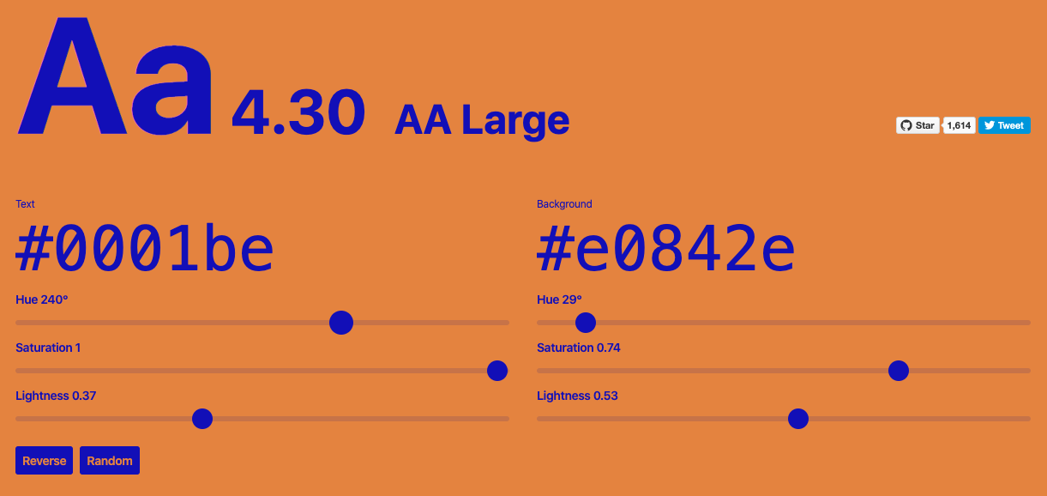
Using Contrast to Enhance
It’s important to provide a contrast for your page to be pleasant, but it’s essential that you do so for users who may be colorblind or have limited vision.
Check out this awesome tool that allows you to enter two colors and get an analysis on if the contrast is acceptable.

Slide 17
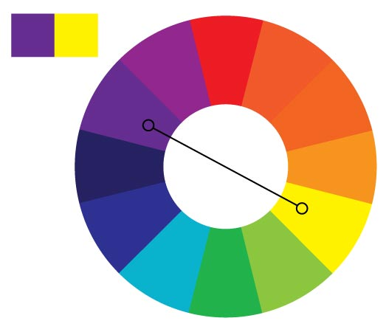
Color Combinations: Complementary
Complementary colors are two colors that sit directly across from each other on the color wheel.
Often have the most contrast
Not always the nicest pairings.

Slide 18
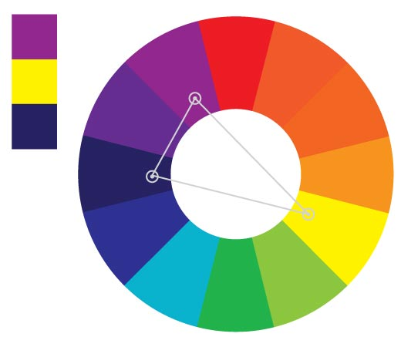
Color Combinations: Split Complementary
To identify split complementary colors:
start with one color
go to either the left or right of the complementary color.
This softens the contrast and often gives a nicer and more visually appealing pairing.

Slide 19
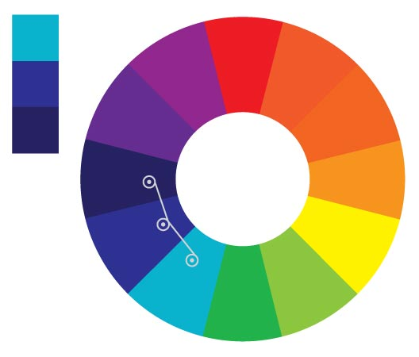
Color Combinations: Analogous
Analogous colors is a group of colors that are close to each other on the color wheel.
Often form a harmonious group because these colors are very similar
Sometimes not enough contrast to be clearly distinguishable from one another

Slide 20
Explore & Discuss
In your breakout group, visit a few of the award-winning websites below. Try to identify what type of color combinations make these site clean and appealing. Be ready to share out what you find!
Snig Digital
Figma
Headspace
Duolingo
House of Idlies
Cleverswim
Spotify’s Culture Next

Slide 21
Discussion Takeaways
It’s important to note that front-end developers do not need to be design experts.
It is okay if selecting colors “isn’t your thing.”
There are some awesome tools out there like Coolors that can help you make a great choice.

Slide 22
“You are not your user.”

Slide 23
“A beautiful website that functions poorly for users with disabilities is like a beautiful skyscraper with only staircases connecting its floors.”

Slide 24
Inclusivity is the practice or policy of providing equal access to opportunities and resources for people who might otherwise be excluded or marginalized.
Inclusive design focuses on building technology that is equally accessible to, representative of, and responsive to everyone.

Slide 25
Solving for One Can Extend to Many
A misconception about inclusive design is that some people believe that inclusive design is solely for a certain subset of people. Designing accessible technology is not a barrier to innovation: solving for one can extend to many.
For example, a solution that works well for someone who is visually impaired might also benefit anyone driving a car!

Slide 26
Wireframing and Planning Your App

Slide 27
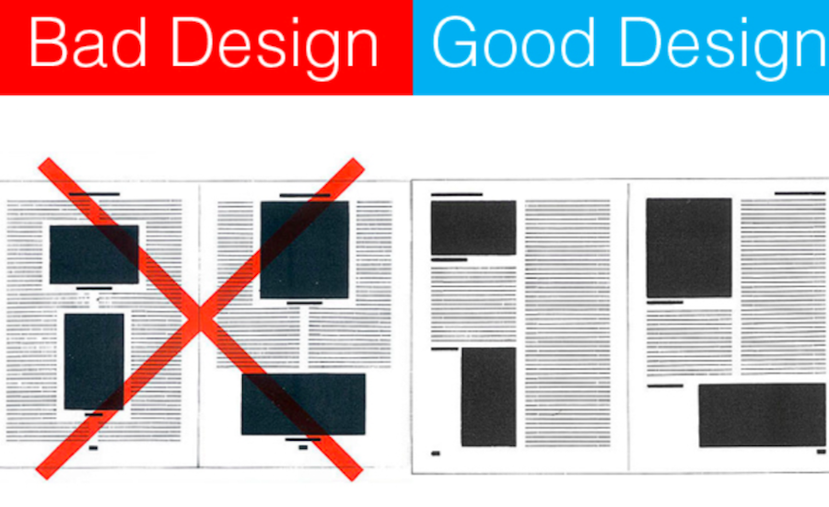
Importance of Planning and Design
Designers spend hours and hours building out a user experience, color palettes, and more.
A great idea can be built into an app, but it might go nowhere with poor design.

Slide 28
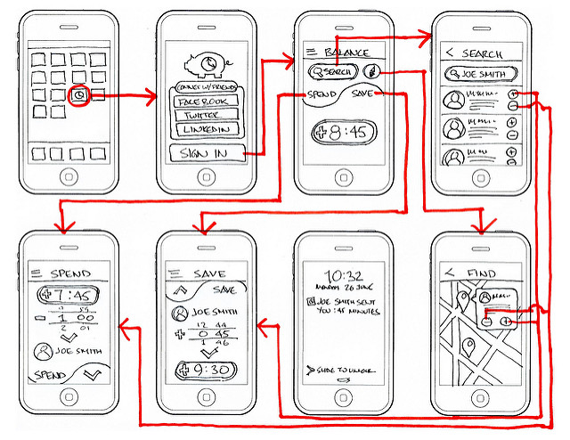
Wireframing
Wireframes are a visual guide for the content and functionality on a page that take into account user experience (UX).

Slide 29
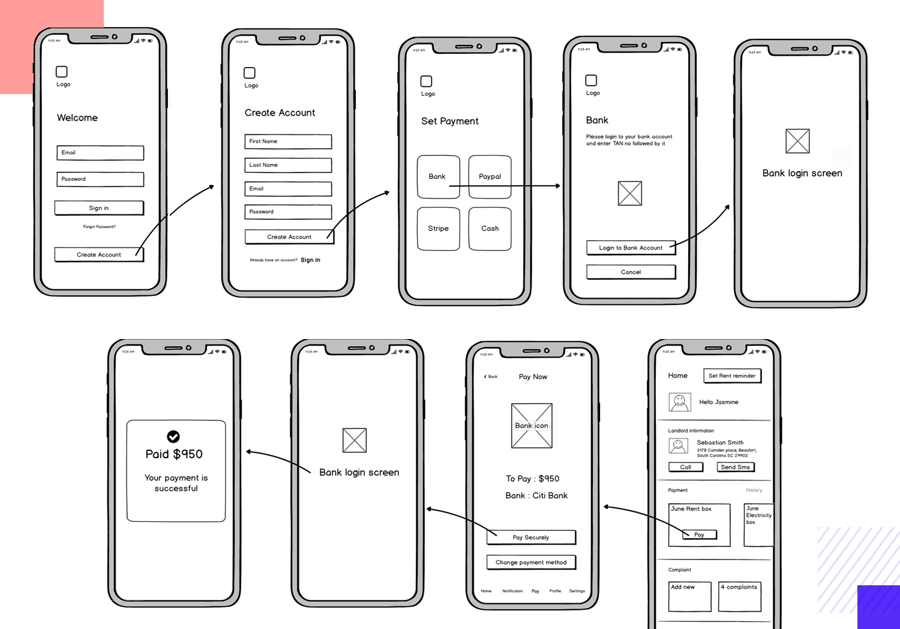
Wireframe Considerations
If the app is responsive, what will it look like on each device size?
If the user moves between pages, how will they navigate?
What Design Principles are being utilized so the page is clear and understandable?
Get user feedback. Ask someone who wasn’t involved in the design process for their opinion.
‹#›

Slide 30
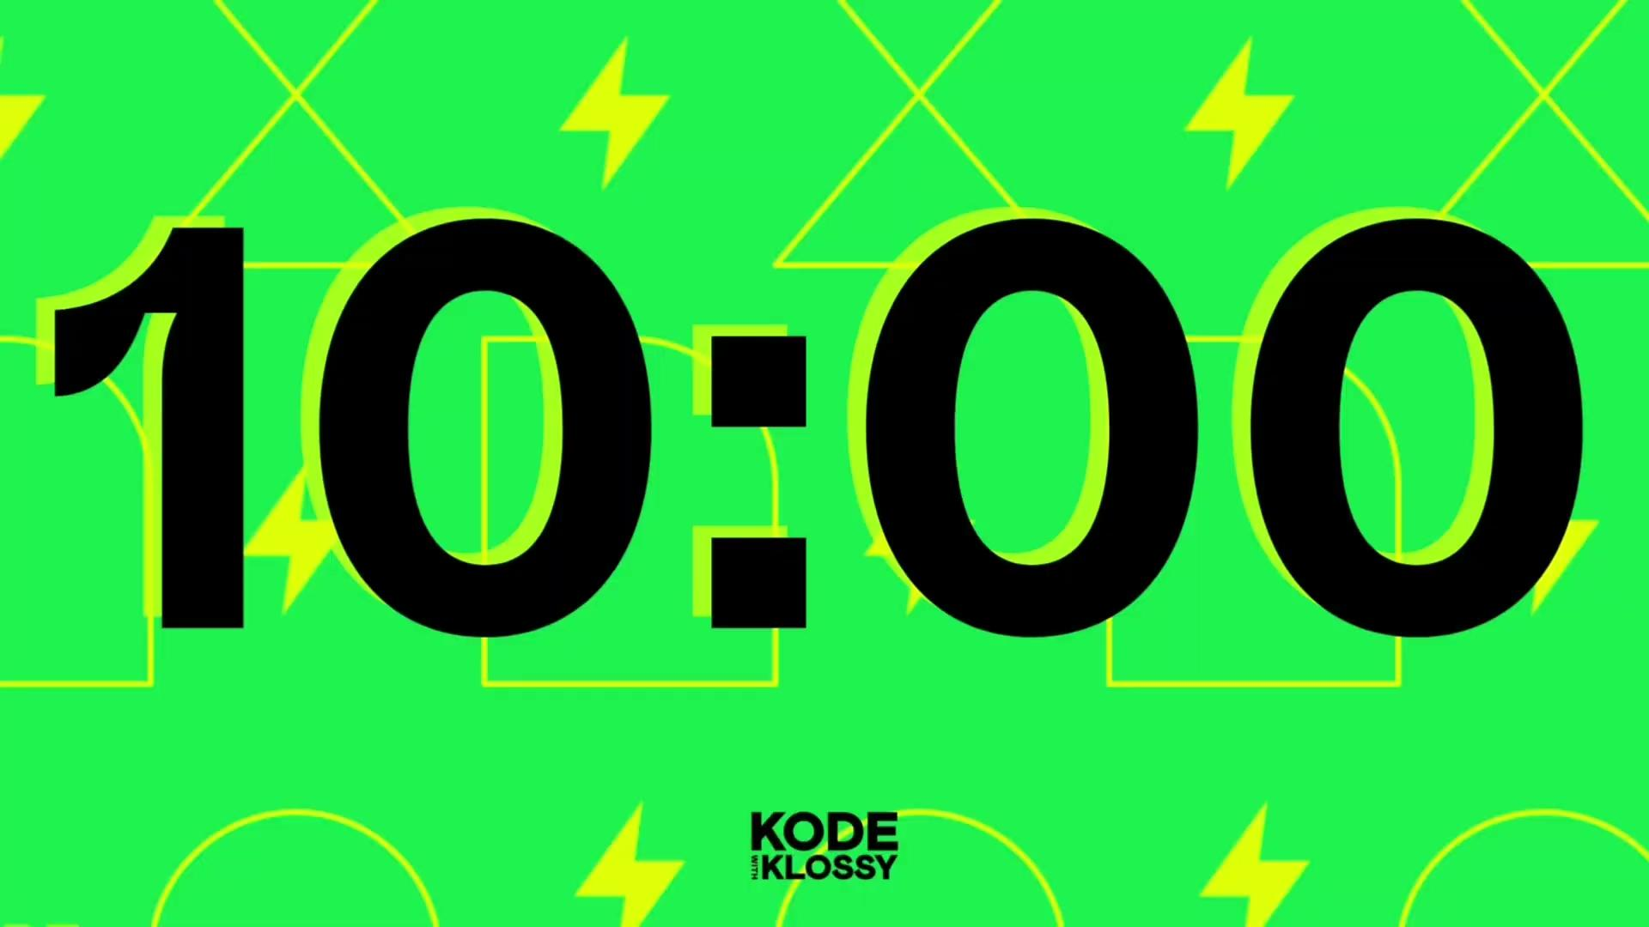
Practice
You've been contracted to design an app for a local restaurant. Pick any restaurant type (e.g. bakery, Italian, etc.)!
Select a color palette, and draw out a wireframe, keeping in mind the Design Principles we've learned about!
Draw a wireframe of at least three different layouts or screens your app might include and consider how the user might navigate from one to the next.
Be ready to share your design and the thinking behind it.

Slide 31
Show & Tell Time
Independently prepare for Show & Tell
Groups of 2-3
Introduce yourself
Go over the wireframe you designed and the thinking behind it
Others should share GLOWS!!!
Switch

